Slide 1


Umamaheswaran & Vishnu Balachandran
Senior Software Engineer – BizTalk360
Introduction to Azure API Apps
Notes:
1.00

Slide 2
Agenda
What is API
What is Azure API Apps
Azure API Concepts
Demo
Develop API
Discoverability
Deployment
Authentication
Consuming APIs
Notes:
30 secs

Slide 3
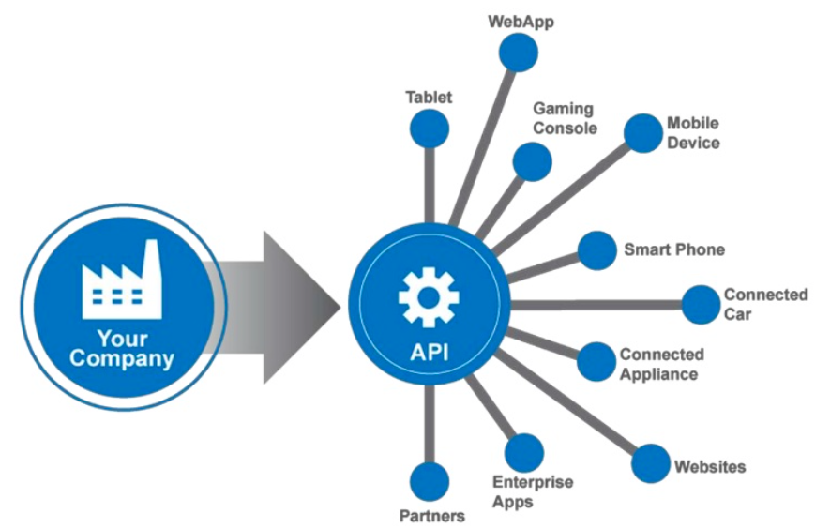
What is API?
Application Programming Interface
Exposing Services and Logic
Web API leverages HTTP Protocol
Availability and Security can be challenging
How Azure App Service can solve this
Notes:
Application Programming Interface
Exposing services and logic in ways which could be easily leveraged by other services and developers
A web API makes it easy to build services and logic over HTTP protocol
It’s a great effort to create availability and security by managing the services themselves in a reasonable and standardized way.
Azure App Service can handle this for us

Slide 4
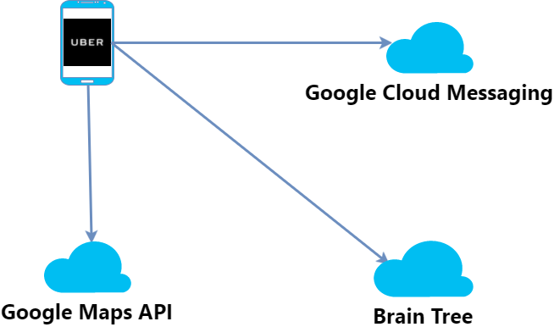

Slide 5
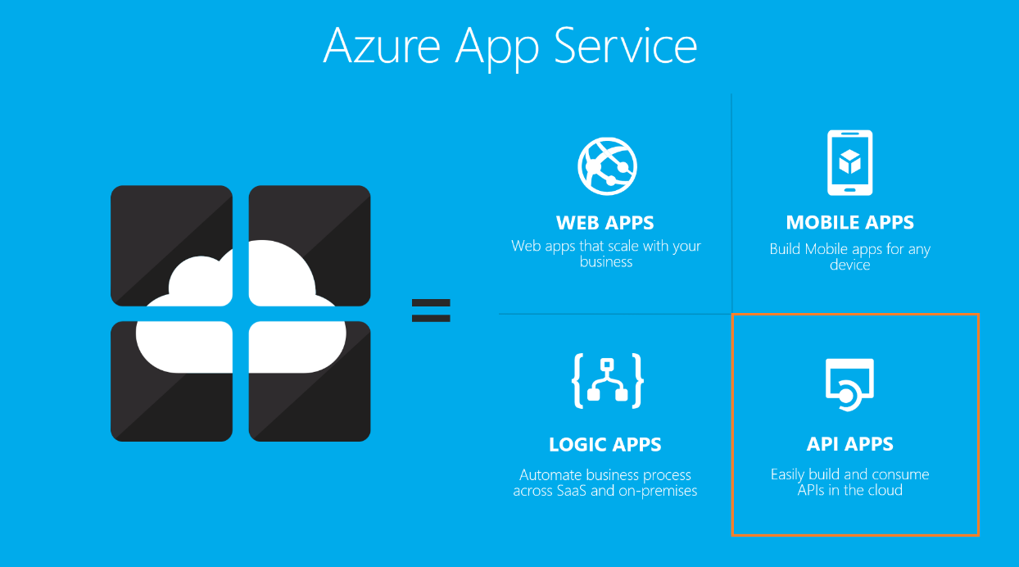
Azure API Apps
API apps makes it easy to develop, host and consume APIs in the cloud and on premises
Leverages enterprise grade security, simple access control, hybrid connectivity,
Automatic SDK generation
Seamless integration with Logic Apps
Versioning
Scaling
Notes:
API Apps are a part of Azure App Service Offering

Slide 6
DEMO

Slide 7
Thank you

